Slide 1

BORDERLINE PERSONALITY DISORDER
~Nayana S

Slide 2

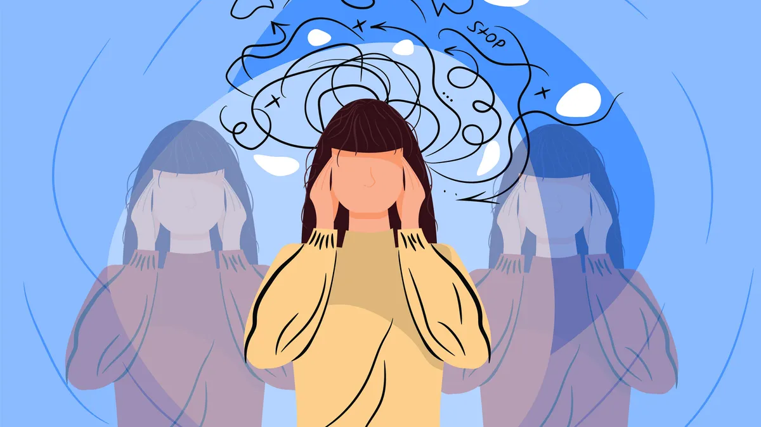
Agenda
Introduction
Symptoms
Treatment
Case study

Slide 3
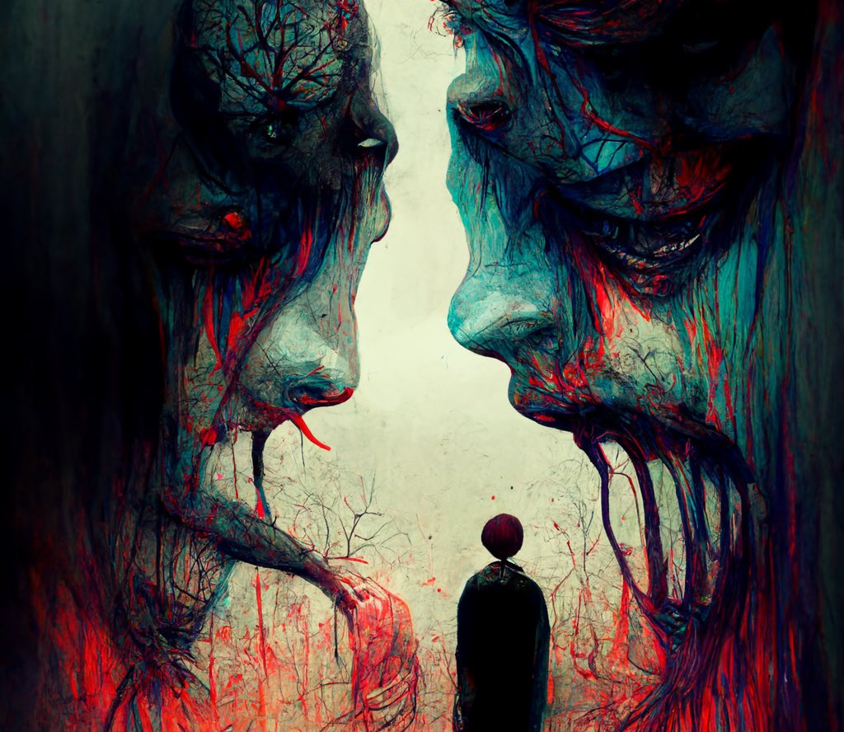
Introduction
Borderline personality disorder is a mental health disorder that impacts the way you think and feel about yourself and others, causing problems functioning in everyday life. It includes self-image issues, difficulty managing emotions and behavior, and a pattern of unstable relationships.

Slide 4
Symptoms
Efforts to avoid real or perceived abandonment, such as plunging headfirst into relationships—or ending them just as quickly.
Impulsive and often dangerous behaviors, such as spending sprees, unsafe sex, substance abuse, reckless driving, and binge eating.
Chronic feelings of emptiness.
Self-harming behavior, such as cutting.
Recurring thoughts of suicidal behaviors or threats.
Feelings of dissociation, such as feeling cut off from oneself, observing oneself from outside one’s body, or feelings of unreality.

Slide 5
Treatment
Medications
Psychotherapy
Because the benefits of prescription medication for borderline personality disorder are unclear, medications aren’t typically used as the primary way to treat the illness. However, in some cases, a psychiatrist may recommend medications to treat specific symptoms or co-occurring mental disorders such as mood swings or depression. Treatment with medications may require coordinated care from more than one medical professional.
Psychotherapy, sometimes called “talk therapy,” is the first-line treatment for people with borderline personality disorder. Most psychotherapy occurs with a licensed, trained mental health professional in one-on-one sessions or with other individuals in group settings. Group sessions may help teach people with borderline personality disorder to interact with others and express themselves effectively.

Slide 6
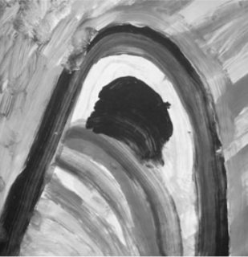

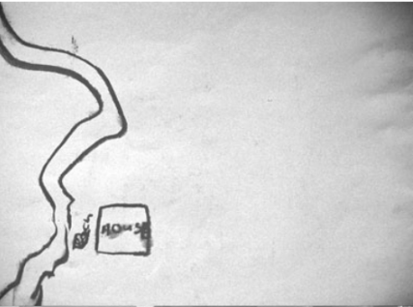
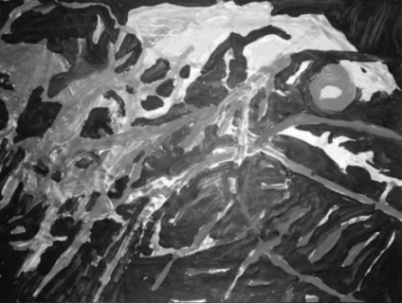

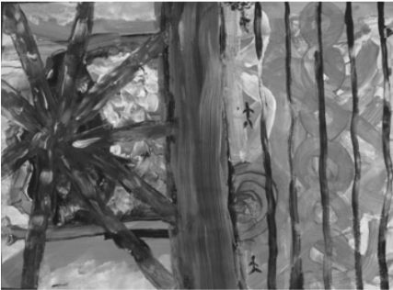
CASE STUDY
ART PSYCHOTHERAPY

Slide 7
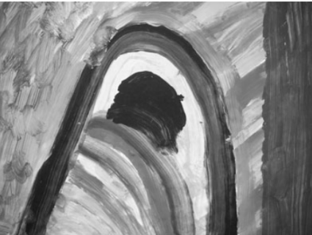
SESSION 1
The patient was able to relive an extremely painful event from the past through the artwork. The patient described being able to express the fear, anger, and humiliation she was currently experiencing.
Then patient was asked to draw anything they wish to and explain their drawing too.

Slide 8
THERAPY SESSION 1
Therapist's Review
The patient was able to relive an extremely painful event from the past through the artwork.
The patient described being able to express the fear, anger, and humiliation she was currently experiencing.
The patient described as she painted: ‘This is a big black cave, I have to paint an opening....The purple is the curtain; I’ve opened it up for you and everyone to see my horror show’

Slide 9
SESSION 4
The patient depicted various allusions. She explained that she painted as things came to her. Through the painting, the patient was able to discuss the anger she felt towards herself and the need to self-harm. The patient also stated that she deliberately gave herself a black eye because she hated herself so much.

Slide 10
THERAPY SESSION 4
Therapist's Review
After she ﬁnished painting, she reﬂected on her work:
‘It looks like a rotting body; it must be me after my next suicide attempt, which I’m planning already. I really have to stop it. It’s against the rules.
Here are my ribs (red lines bottom right hand corner) and this is the body (yellow and orange at top of page), it’s just rotting away.
I guess that’s how I’ll look; it must be me rotting here. I just want to be chucked in the ground. I don’t want a cofﬁn. If you are in the ground, does it take a long time for the worms to get you?’

Slide 11
SESSION 6,7,8,9
The patient arrived late and had ﬁfteen minutes to paint for the session 6.
The patient was 40 minutes late for session 7.
The patient was late and said little during session 8.

Slide 12
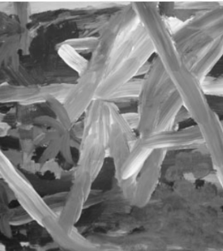
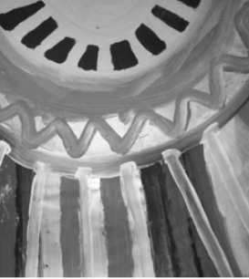
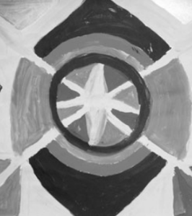
Therapist's Review
The patient was much calmer in these sessions and did not discuss any disturbing material.
She remembered some happy times of living in the farmhouse. She used a lot of green colour in her drawings which symbolized 'growth'.

Slide 13
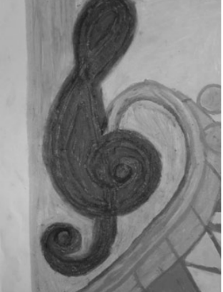
SESSION 11
This was her ﬁnal piece of artwork in the individual sessions. The consumer described the yellow line as herself:
‘It also looks like the stream from my childhood (referring to the drawing in session 7)....Yes, I could title this one
“Battles of my Childhood Memories.”’
The consumer proudly showed an image of a treble and base clef and described the pastel drawing: ‘This is about my music. I like playing. I thought of what I liked and what made me calm.’

Slide 14
THERAPY SESSION 11
Therapist's Review
She also reﬂected on the art therapy sessions: ‘It’s been a wonderful experience. Thank you for your time with me to listen and let me think about my life. I like my paintings so much I am going to hang them up in my new ﬂat’.
The consumer was able to take the experience of painting from the sessions and use it to focus on things that the consumer enjoyed.
The consumer could now use this medium to help relax, as was suggested. The consumer reported now being able to focus on a love of playing music.

Slide 15
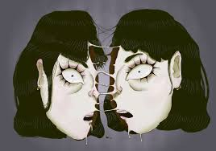
It is not the bruises on the body that hurt. It is the wounds of the heart and the scars on the mind.
Aisha Mirza

Slide 16
Bibliography
(PDF) Art psychotherapy in a consumer diagnosed with borderline personality disorder: A case study (researchgate.net)
Borderline Personality Disorder (BPD) - HelpGuide.org
Borderline personality disorder - Symptoms and causes - Mayo Clinic
NIMH » Borderline Personality Disorder (nih.gov)

Slide 17
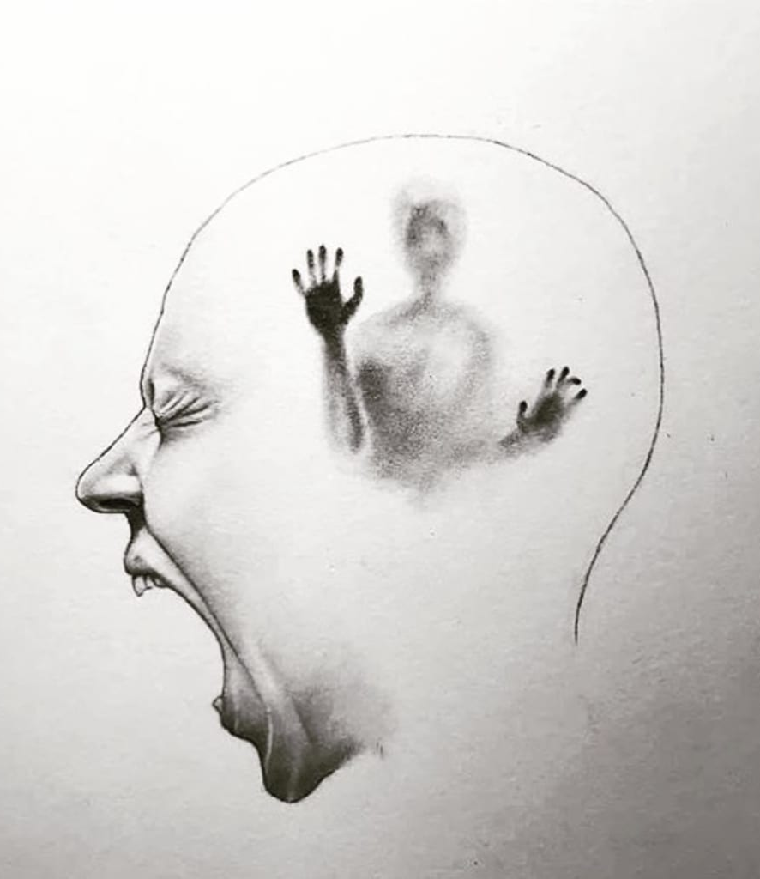
Thank you
Nayana S
XII D
Sri Vijay Vidyashram

